Slide 1

STAT 6440 GROUP 7
Presented By:
Huda Abdaljalil, Tanjima Rahman
Department of Applied Statistics
04/18/2024

Slide 2
A data mining logistic classifier approach for identifying the socio-economic determinants of early intention of antenatal care (ANC) in Bangladesh

Slide 3

Outline
Background of the study
Objectives
Methodology
Results
Conclusion

Slide 4
Background
With technology’s help, stillbirth rates may have been reduced, but pregnancy related complications are still a problem to overcome.
Antenatal care (ANC)
Probability of attending ANC depends on different factors; religious, cultural, geographical, socioeconomic and demographic.
There have been few studies on this topic all over the world (Yuba Raj Paudel, 2017) (Keolebogile M. Selebano, 2021) (Abdul Aziz Seidu, 2022).

Slide 5
Objectives
To examine the socio-economic factors that are affecting the choice of having early ANC visits during pregnancy.
Best feature selection approach.

Slide 6
Methodology

Slide 7
Source of data
Used secondary national representative survey data, named Bangladesh Demographic and Health Survey, 2017-18.
4,604 women who gave birth preceding three years of the survey, were included for further analysis.
Response variable of this study was “Women who attended early ANC visits”.
Some socio-economic characteristics were used as regressor variables.

Slide 8
Difficulties
Missing values
Which made the analyzation difficult and less precise.

Slide 9
Methods for variable selection process
First, ran the logistic regression method
Several variable selection methods were used
Stepwise with cross validation approach
Lasso Regression Ridge Regression
Decision Tree
Bagging
Random Forest
Adaboost
Finally, logistic regression was run again
Notes:
First ran the logistic regression method.
Several variable selection methods have been used:
Used a variable selection method
Stepwise with cross validation approach.
Used regularized regression
Lasso Regression.
Ridge Regression.
Used classification tree
Decision tree.
Used ensemble methods
Bagging.
Random forest.
Adaboost.
3. Finally logistic regression was run again

Slide 10
Results

Slide 11
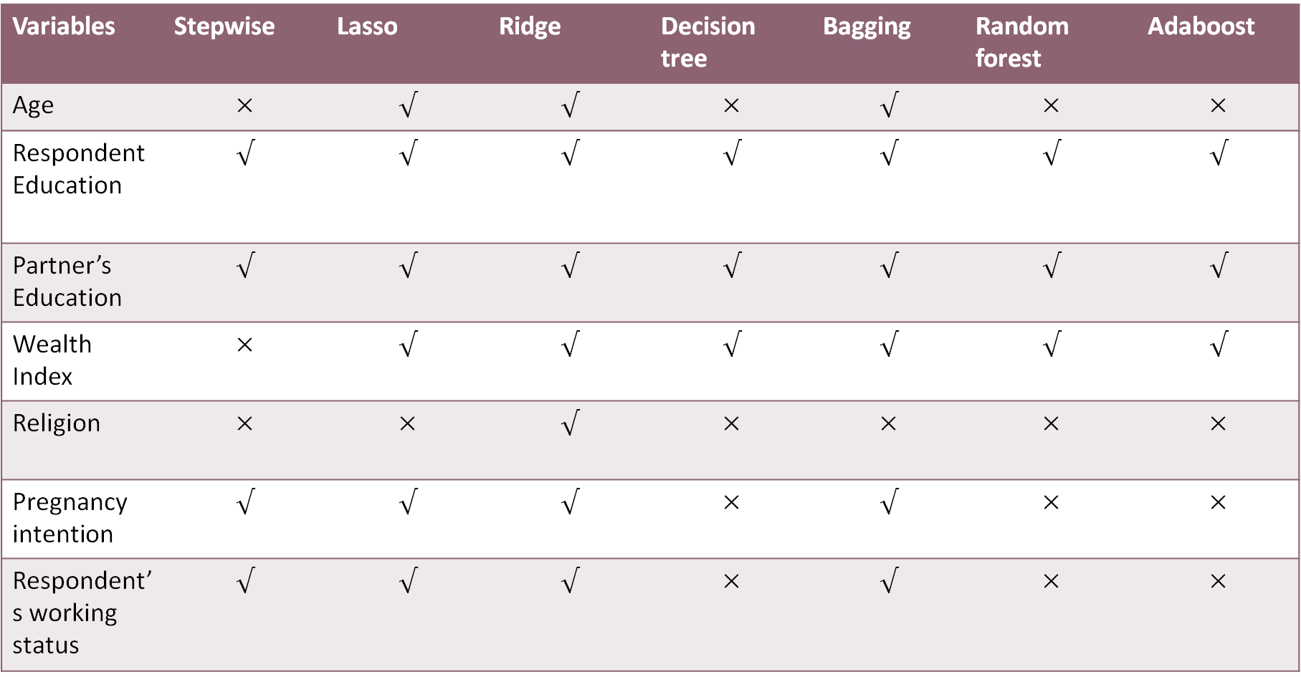
Selected variables in different methods
Variables | Stepwise | Lasso | Ridge | Decision tree | Bagging | Random forest | Adaboost
Age | $$×$$ | $$√$$ | $$√$$ | $$×$$ | $$√$$ | $$×$$ | $$×$$
Respondent Education | $$√$$ | $$√$$ | $$√$$ | $$√$$ | $$√$$ | $$√$$ | $$√$$
Partner’s Education | $$√$$ | $$√$$ | $$√$$ | $$√$$ | $$√$$ | $$√$$ | $$√$$
Wealth Index | $$×$$ | $$√$$ | $$√$$ | $$√$$ | $$√$$ | $$√$$ | $$√$$
Religion | $$×$$ | $$×$$ | $$√$$ | $$×$$ | $$×$$ | $$×$$ | $$×$$
Pregnancy intention | $$√$$ | $$√$$ | $$√$$ | $$×$$ | $$√$$ | $$×$$ | $$×$$
Respondent’s working status | $$√$$ | $$√$$ | $$√$$ | $$×$$ | $$√$$ | $$×$$ | $$×$$

Slide 12
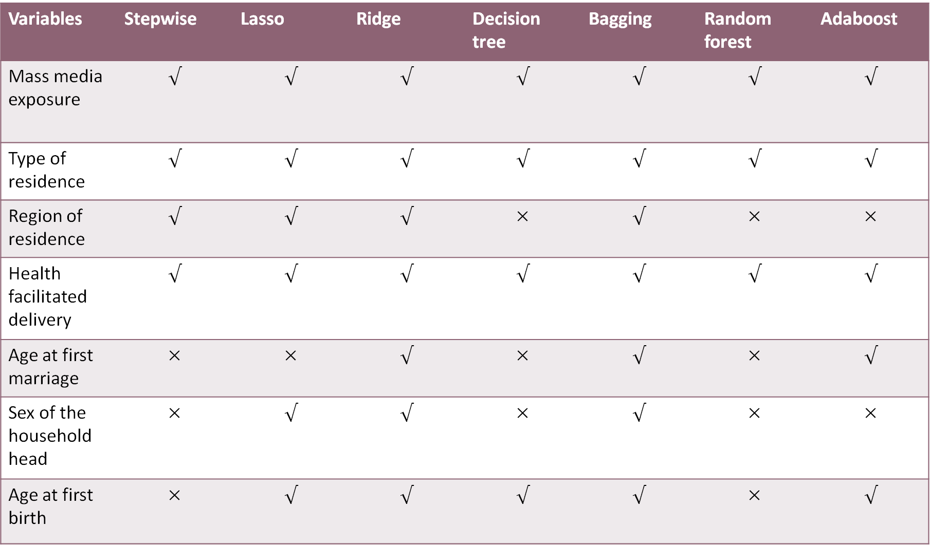
Variables | Stepwise | Lasso | Ridge | Decision tree | Bagging | Random forest | Adaboost
Mass media exposure | $$√$$ | $$√$$ | $$√$$ | $$√$$ | $$√$$ | $$√$$ | $$√$$
Type of residence | $$√$$ | $$√$$ | $$√$$ | $$√$$ | $$√$$ | $$√$$ | $$√$$
Region of residence | $$√$$ | $$√$$ | $$√$$ | $$×$$ | $$√$$ | $$×$$ | $$×$$
Health facilitated delivery | $$√$$ | $$√$$ | $$√$$ | $$√$$ | $$√$$ | $$√$$ | $$√$$
Age at first marriage | $$×$$ | $$×$$ | $$√$$ | $$×$$ | $$√$$ | $$×$$ | $$√$$
Sex of the household head | $$×$$ | $$√$$ | $$√$$ | $$×$$ | $$√$$ | $$×$$ | $$×$$
Age at first birth | $$×$$ | $$√$$ | $$√$$ | $$√$$ | $$√$$ | $$×$$ | $$√$$

Slide 13
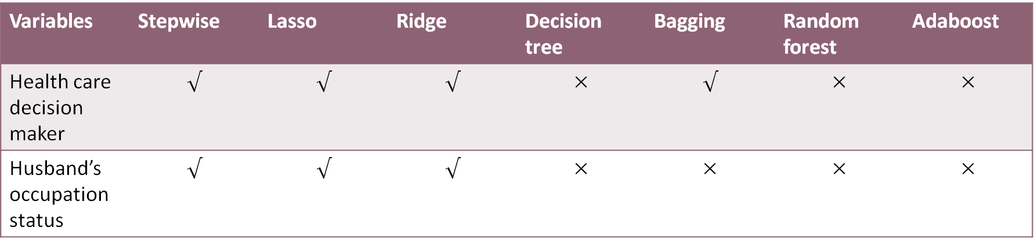
Variables | Stepwise | Lasso | Ridge | Decision tree | Bagging | Random forest | Adaboost
Health care decision maker | $$√$$ | $$√$$ | $$√$$ | $$×$$ | $$√$$ | $$×$$ | $$×$$
Husband’s occupation status | $$√$$ | $$√$$ | $$√$$ | $$×$$ | $$×$$ | $$×$$ | $$×$$

Slide 14
Model comparison with respect to Accuracy and kappa value
Methods | Accuracy | kappa
Stepwise | 0.6315 | 0.2074
Lasso | 0.6458 | 0.2333
Ridge | 0.6392 | 0.2225
Decision tree | 0.6381 | 0.2222
Bagging | 0.5941 | 0.1413
Random forest | 0.6612 | 0.2547
Adaboost | 0.6524 | 0.2377

Slide 15
Model comparison with Lift chart

Slide 16
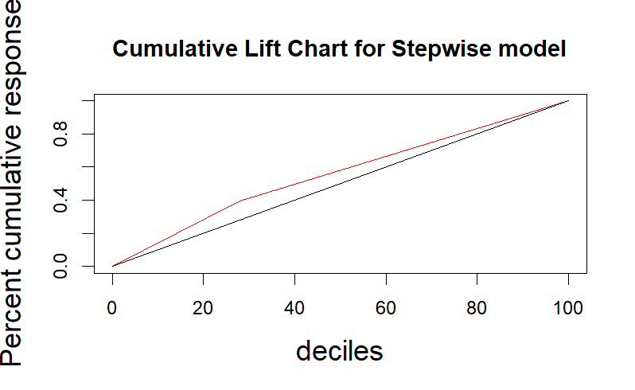
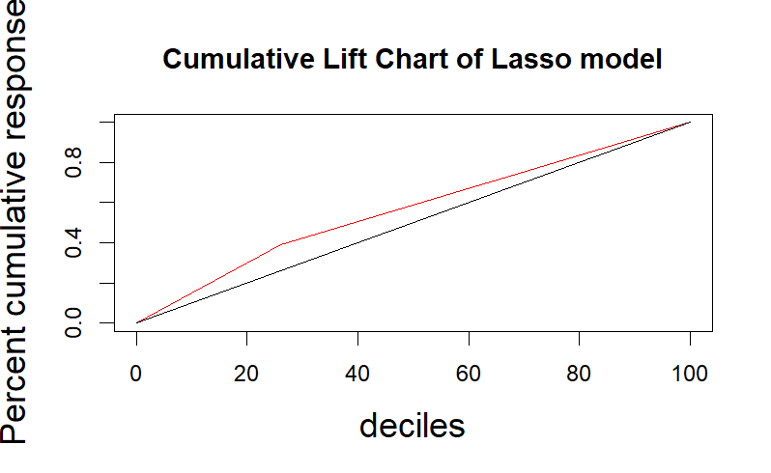
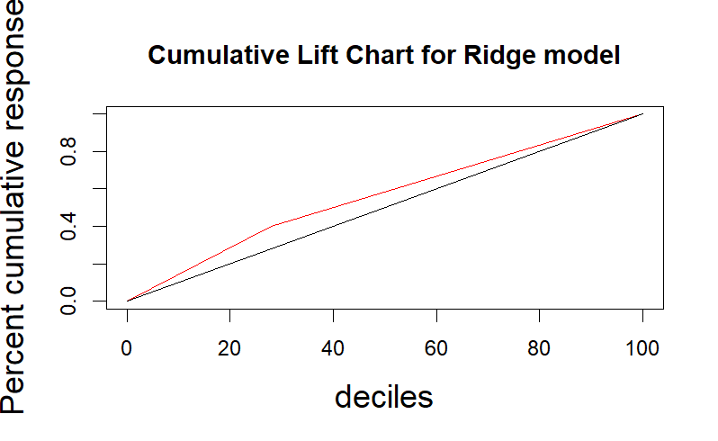
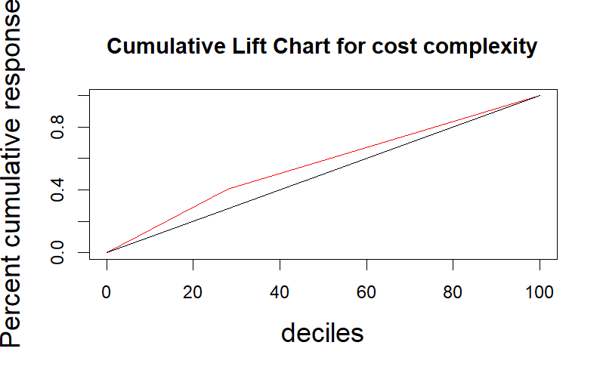
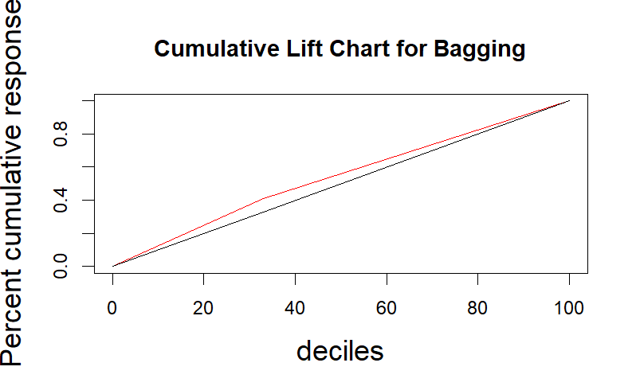
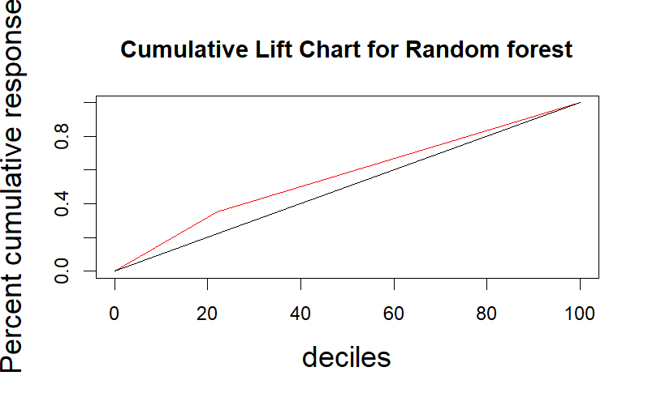
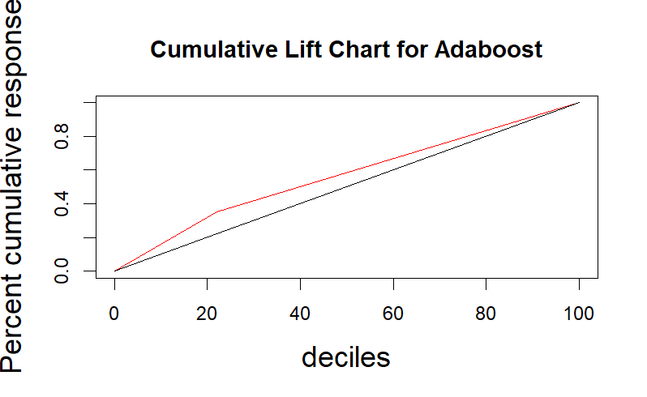

Slide 17
Before variable selection
Variable | Significant/ Not significant | Variable | Significant/ Not significant
Age | Not significant | Type of residence | Significant
Respondent Education | Significant | Region of residence | Significant
Partner’s Education | Significant | Health facilitated delivery | Significant
Wealth Index | Not significant | Age at first marriage | Not significant
Religion | Not significant | Sex of the household head | Not significant
Pregnancy intention | Significant | Age at first birth | Not significant
Respondent’s working status | Significant | Health care decision maker | Significant
Mass media exposure | Significant | Husband’s occupation status | Not significant

Slide 18
After variable selection
Variable | Significant/ Not significant
Respondent Education | Significant
Partner’s Education | Significant
Wealth Index | Not significant
Mass media exposure | Significant
Type of residence | Significant
Health facilitated delivery | Significant
Age at first birth | Not significant

Slide 19
Conclusion
In this study we used several supervised algorithms and finally identified one of them as best working for this data.
Many factors contribute to this phenomenon, such as, education (both respondent’s and partner’s), residence status, mass media and so on.
For future research, longitudinal studies could be considered to establish relation between early antenatal care and maternal health outcomes.

Slide 20
Question and Answer

